Slide 1

Your past, your present and your future

Slide 2


Slide 3
Overview
Idea
Technologies
Competitors
Costs
Team
Planification
Demo
Piloting plan

Slide 4
IDEA
What is Capsulefy?

Slide 5





Time capsule

Slide 6


Payment plans
 | Free | Premium
Price | 0 € | 11.99 €
Storage | 20 MB/user | 500 MB/capsule
Social network and email integration
Capsule scheduling | 1 year | No limit
Capsule expiration | 6 months after release | No expiration
Modular and private capsules

Slide 7
TECHNOLOGIES
What stack do we use?

Slide 8




Web app
Users and capsules
Media storage
Social network

Slide 9


Testing
Functional and integration
Performance
Coverage

Slide 10





Slide 11
Travis CI builds
All branches |  |  | Master
Passed | Failed | Cancelled | Passed | Failed | Cancelled
361 | 104 | 42 | 23 | 14 | 2
Total: 407 |  |  | Total: 37

Slide 12


Code coverage
0
50
75
85
100
!
~
Before sprint 3, week 1: 42 %
After sprint 3, week 1: 78 %

Slide 13
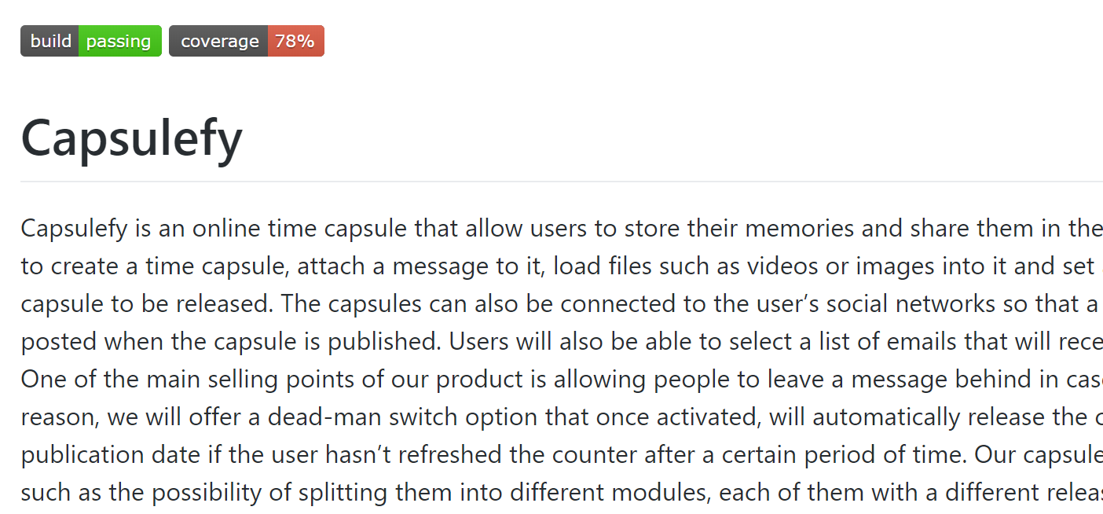

Slide 14

Release naming
1 | Devising a project
2 | Sprint 1
3 | Sprint 2
4 | Sprint 3
…
Release X
X =

Slide 15
URL naming
1 | Landing page
2 | Sprint 1
3 | Sprint 2
4 | Sprint 3
capsulefy0X
.herokuapp.com
X =

Slide 16
COMPETITORS
What makes us different?

Slide 17
 | Viajeros en el tiempo | Mytimecapsule | Miigen | thetimecapsule | Capsulefy
Automatic content publication
Free plan
Premium plan
Images
Videos
Social network integration
Deadman switch

Slide 18
COSTS
How much does Capsulefy cost?

Slide 19
Project duration | 4 months
Salaries | 20.80 €/hour
Hours per month | 40
Amortization | 60 months
Equipment | 306 €
Hosting (1 year) | 669 €
Advertising (6 months) | 3060 €
Customer support (1 year) | 15000 €
Risk prevention | 10% (2724 €)
Total | 44968 €

Slide 20
TEAM
Who is behind?

Slide 21
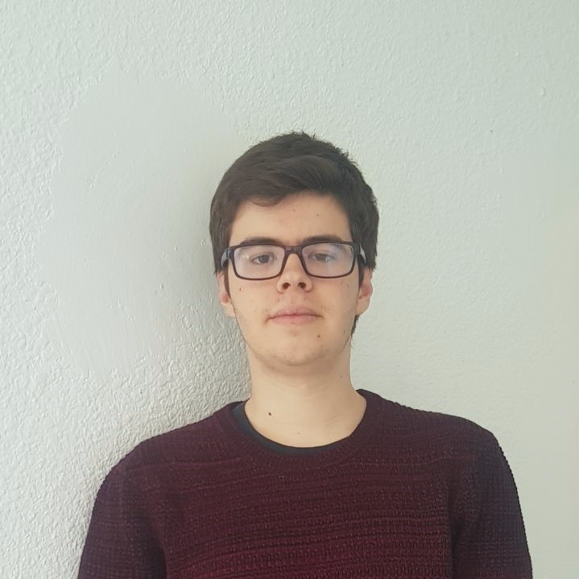
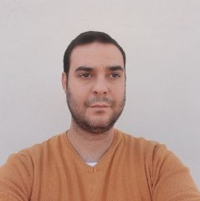




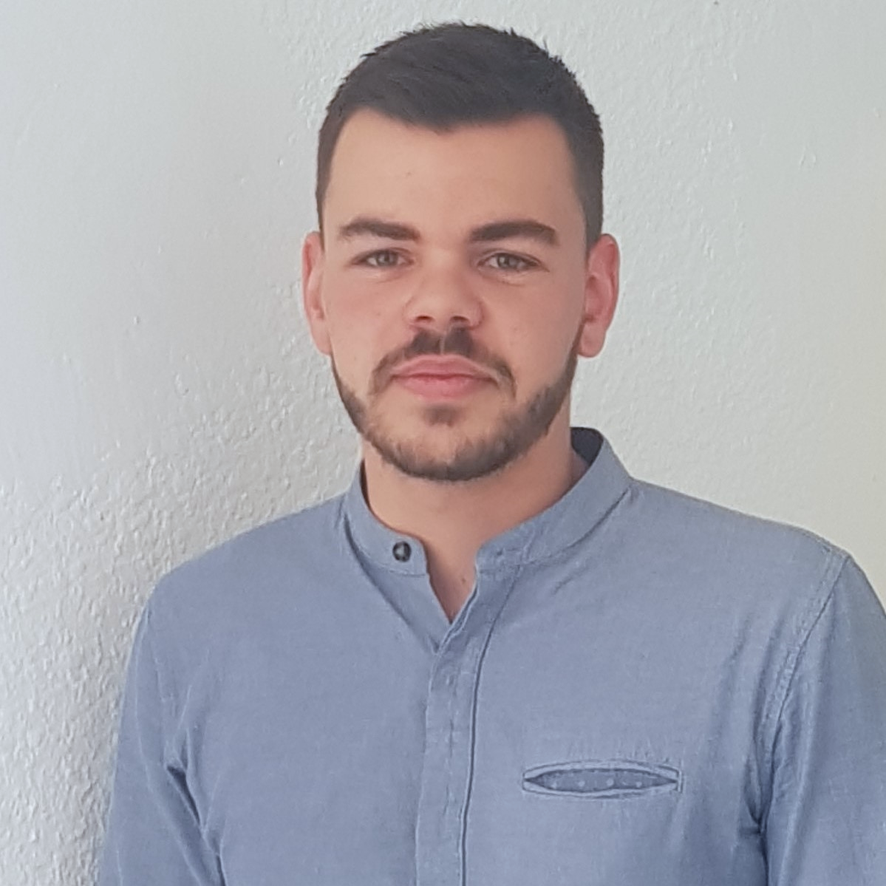
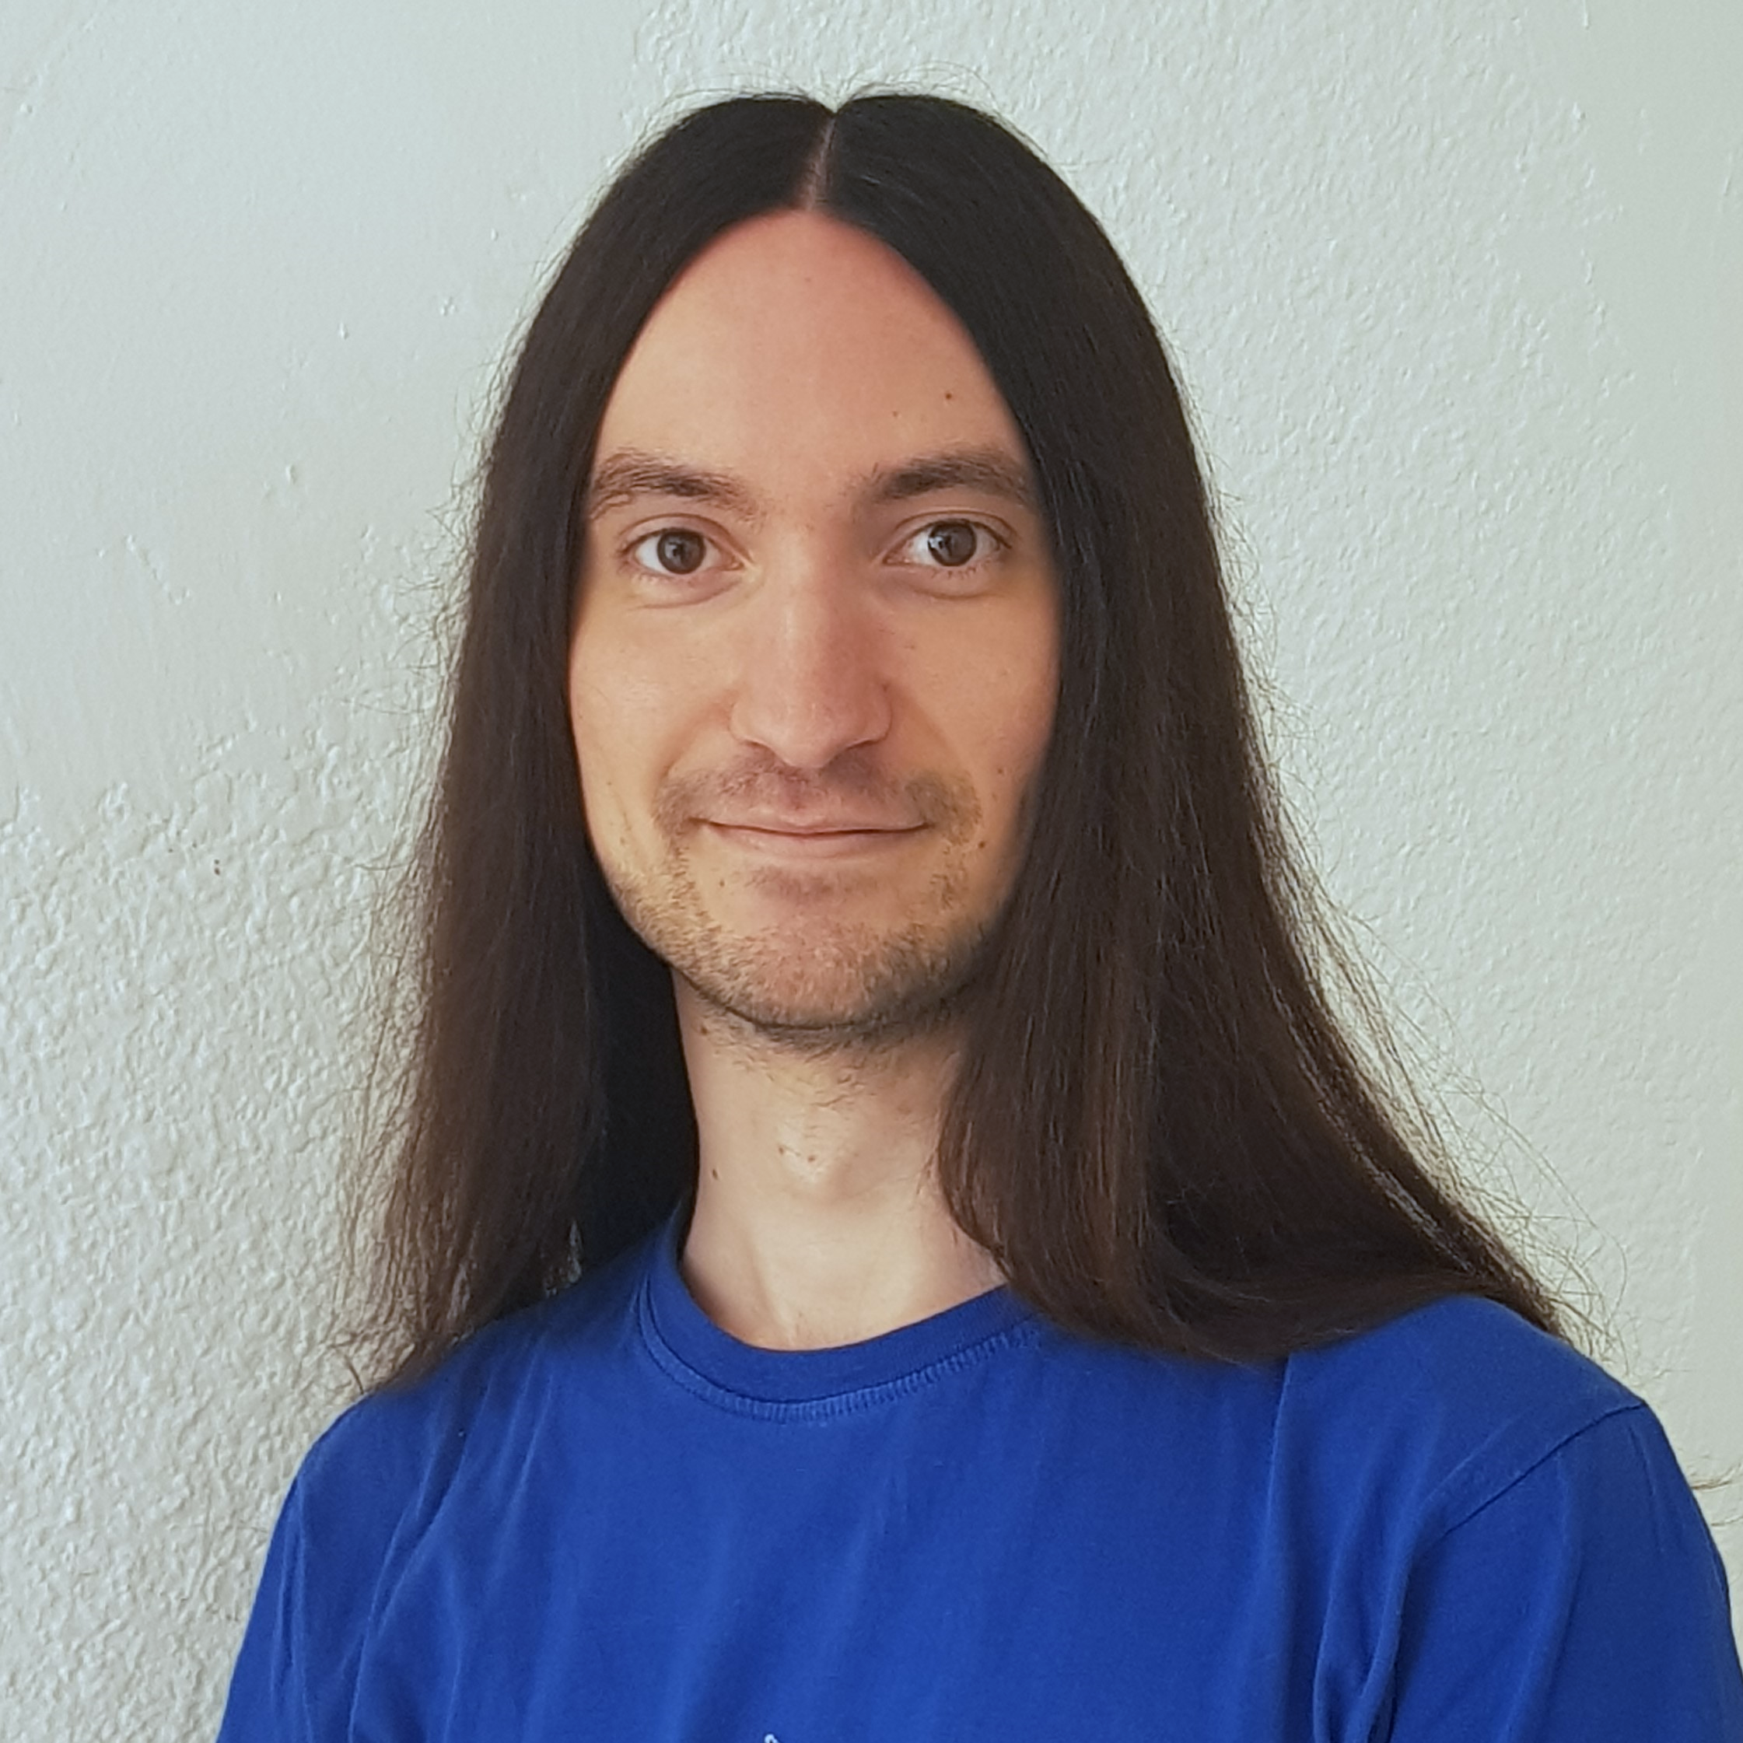


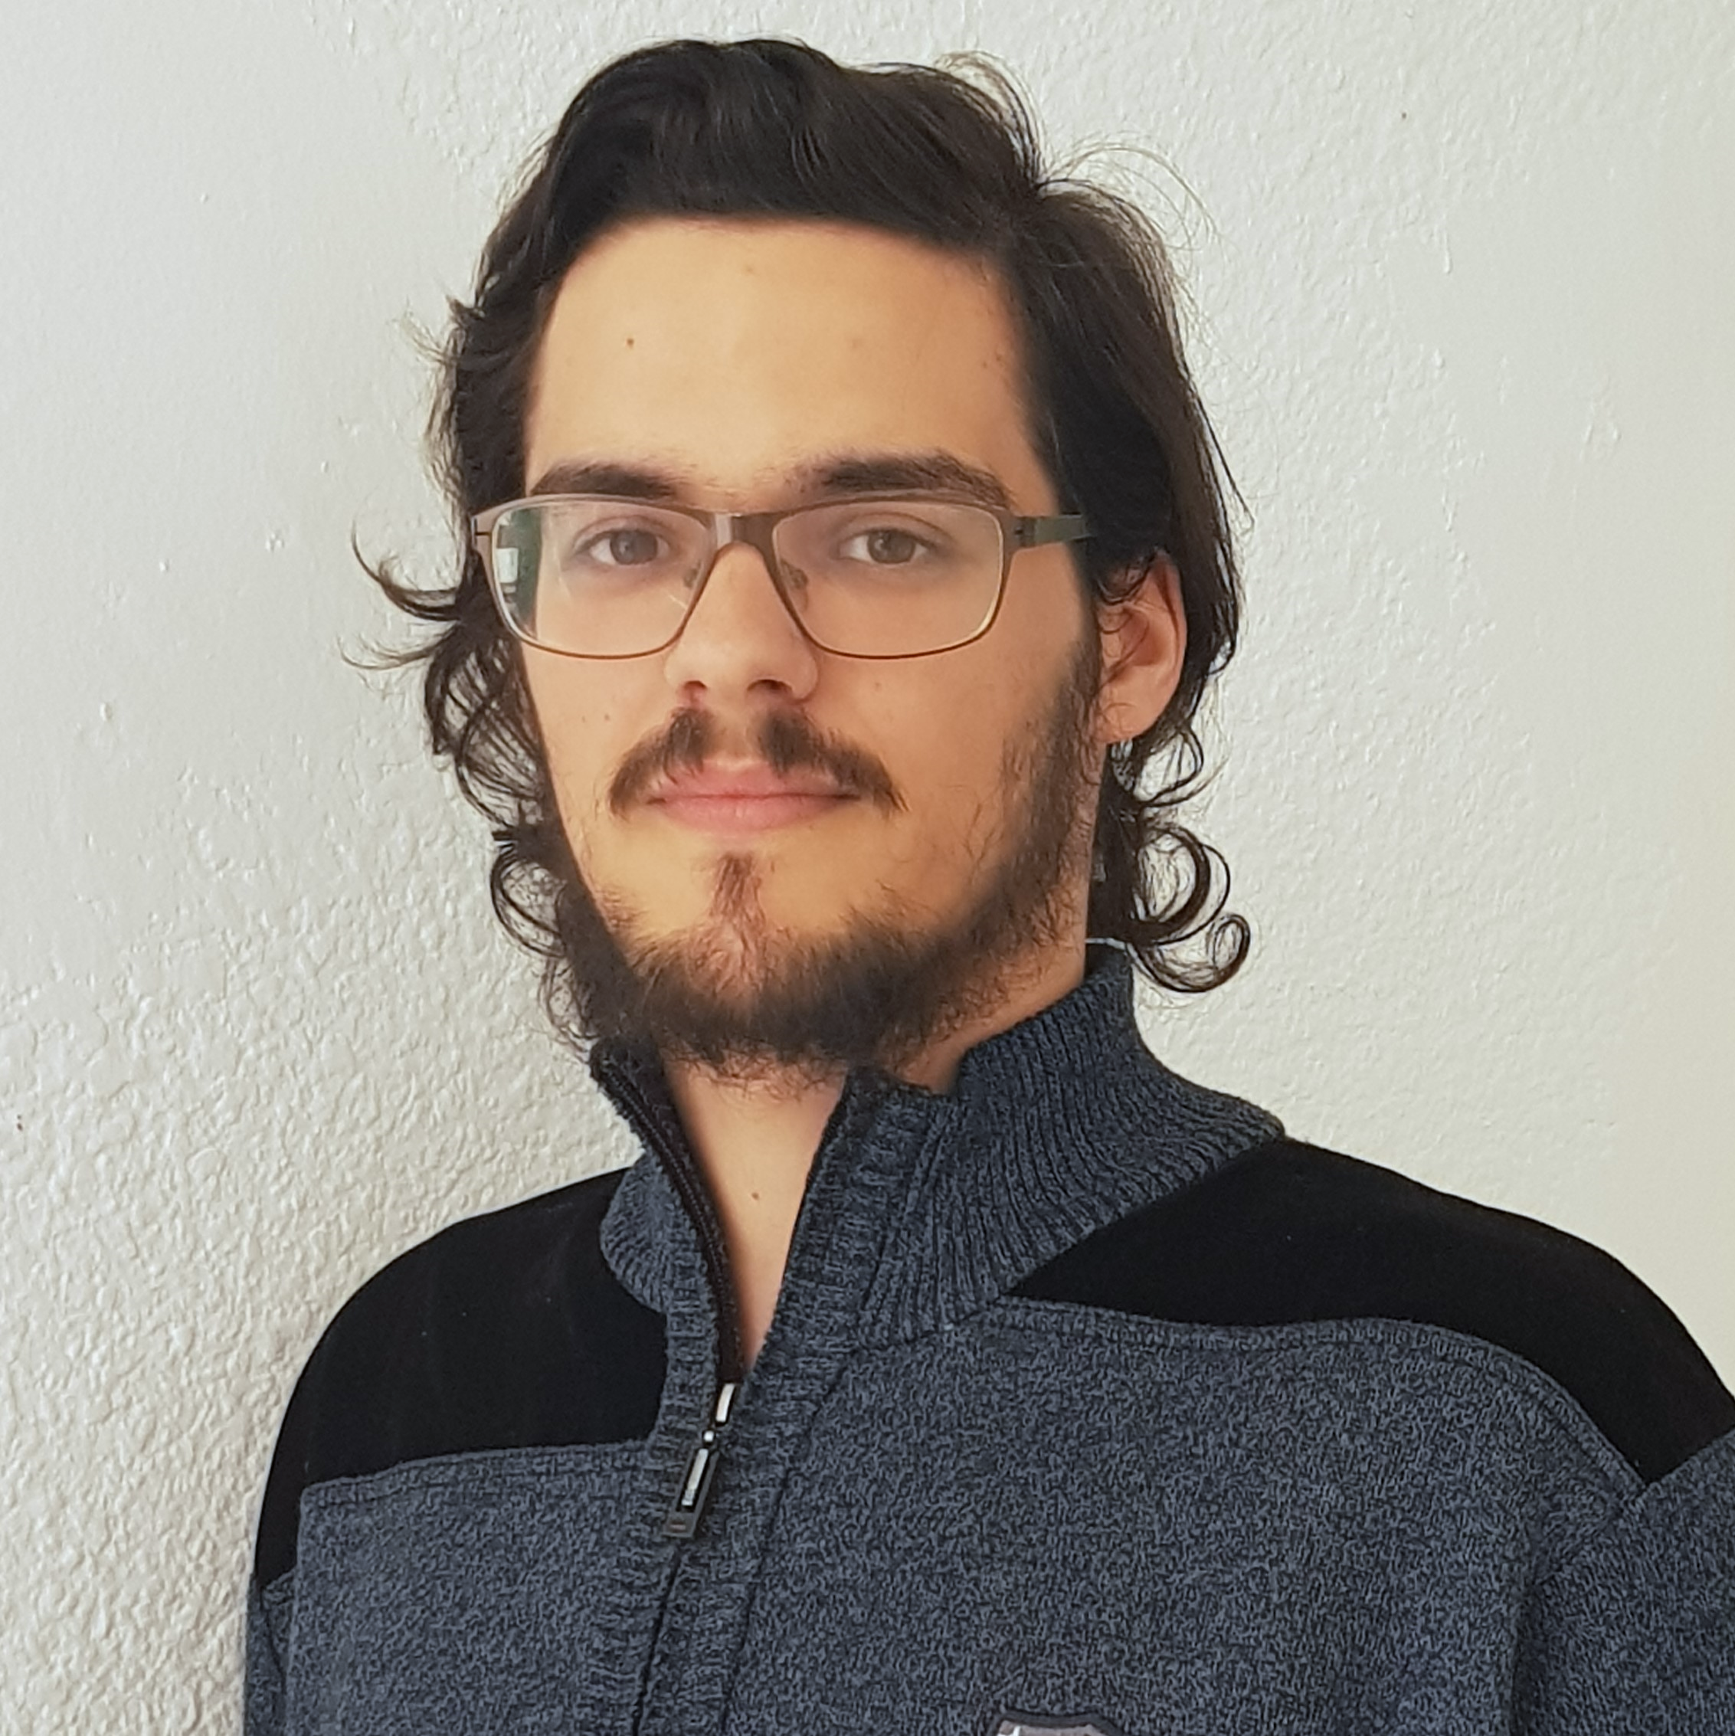



Pablo Rebollo
Project manager, backend developer
Juan Rodríguez
Requirements engineer, backend developer
Adrián Cantón
Business manager, full-stack developer
Rafael Fresno
Backend developer, API integration
Daniel Carpio
Analist,
frontend developer

Slide 22
PLANIFICATION
How do we organize development?

Slide 23
First sprint March 18th – March 29th | Core use cases Piloting plan
Second sprint April 1st – April 12th | Full MVP Feedback taken into account
Third sprint April 22nd – May 3rd | Polished MVP

Slide 24


Performance indicator
$$avg(\frac{Estimated time}{Invested time})$$
0.5
0.8
1.2
1.5
!
~
?

Slide 25
PM performance indicator
$$PMP∗avg\left(MP\right)−TD∗0.1$$
PMP: Project Manager performance
MP: Members performance
TD: Total task delays (days)
0.5
1.5
!
~
?

Slide 26

Relative performance indicator
$$\frac{avg(This week performance)}{avg(Last week performance}$$
0.5
0.8
1.2
1.5
!
~
?

Slide 27



Factors affecting performance
Optimistic estimation
Wasted time
Difficulties
Pesimistic estimation
Easier tasks
Unknown technology

Slide 28



General solutions
Talk
Reschedule
Balance
Monitor

Slide 29
SPRINT 3 WEEK 1
April 22nd – April 28th

Slide 30
 |  | April
Task | Assignees | 22 | 23 | 24 | 25 | 26 | 27 | 28
Initial meeting | All
Improve checkboxes | Daniel
Coverage tests | Rafael
Unit tests | Adrián
Improve responsive | Daniel
Improve demo videos | Adrián
Add date picker | Juan
Fix sign up message | Juan

Slide 31
 |  | April
Task | Assignees | 22 | 23 | 24 | 25 | 26 | 27 | 28
Update costs | Pablo
GDPR | Pablo
Improve return button | Daniel
Improve 404 pages | Daniel
Improve email inputs | Daniel
Landing page content | Juan
Fix image proportions | Daniel
Test automation results | Pablo

Slide 32
 |  | April
Task | Assignees | 22 | 23 | 24 | 25 | 26 | 27 | 28
Improve dashboard | Juan
Review populate | Pablo
Presentation | Rafael
Advertisement video | Pablo
Rehearsal | Pablo

Slide 33
Performance
Pablo (PM) | 1.09
Daniel | 0.88
Rafael | 0.93
Adrián | 0.83
Juan | 1.1

Slide 34
Relative performance
This week | 0.96
Last week | 1.28
Result | 0.75

Slide 35
Project duration | 10 weeks (5 development)
Total salaries | 9797 €
Amortization | 60 months
Equipment | 265 €
Hosting and advertising | 0 €
Customer support | 15000 €
Risk prevention | 2724 €
Total | 9455 €
Project completion | 66 %
Spent budget | 61 %

Slide 36


What went wrong?
- What happened?
Two tasks had some delays.
- Solution
The PM will pay more
attention to task progress.
Task delays

Slide 37

What went wrong?
- Measure
Greatest delay in week 2 (days)
!
Task delays
2
3

Slide 38





What went wrong?
- What happened?
Creating a Facebook dev
account was not easy.
- Solution
Assign more people.
Facebook integration

Slide 39
What went wrong?
- Measure
Task completion in week 2 (%)
!
Facebook integration
50
75

Slide 40

Measures
Performance ratio
!
~
?
0.5
0.8
1.2
1.5
Divide tasks
W1 lowest performance: 0.83

Slide 41
Measures
Delay (days)
!
2
3
Divide tasks
W1 greatest delay: 1

Slide 42

Measures
Invested hours
!
6
7
Divide tasks
W1 task with most hours: 6

Slide 43

Measures
Invested days
!
6
7
Divide tasks
W1 task with most days: 4

Slide 44

Measures
Wiki entries
!
3
4
Better
tool usage
Wiki entries after W1: 6

Slide 45
DEMO
How does the system look like?

Slide 46
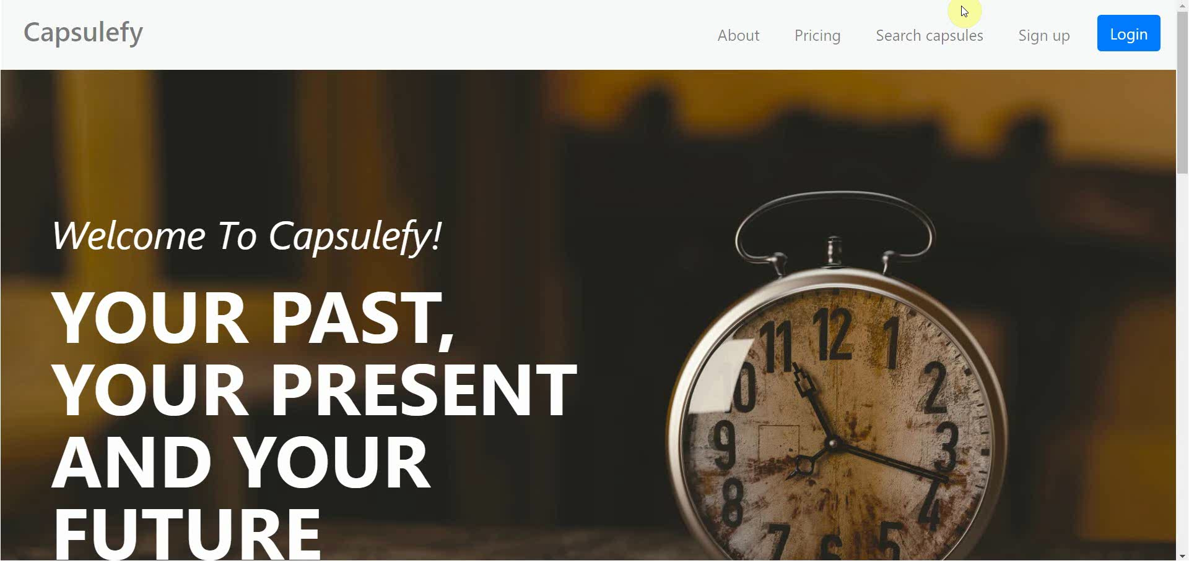
No logged user – List, search and display capsules

Slide 47

No logged user – Sign up

Slide 48
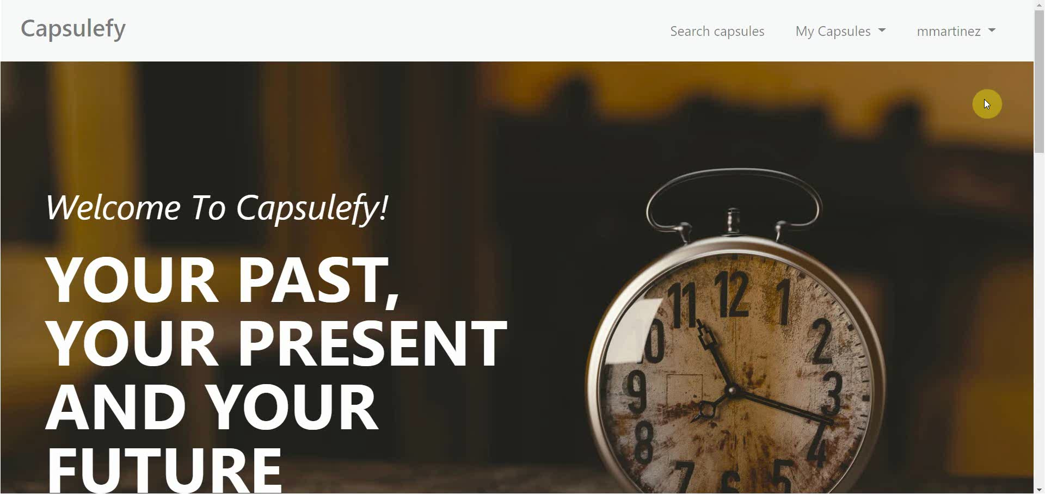
Logged-in user – My account

Slide 49
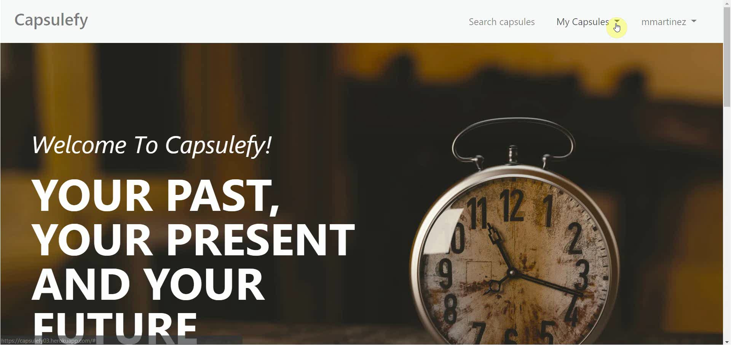
Logged-in user – Modular capsules

Slide 50

Logged-in user – Edit capsules

Slide 51
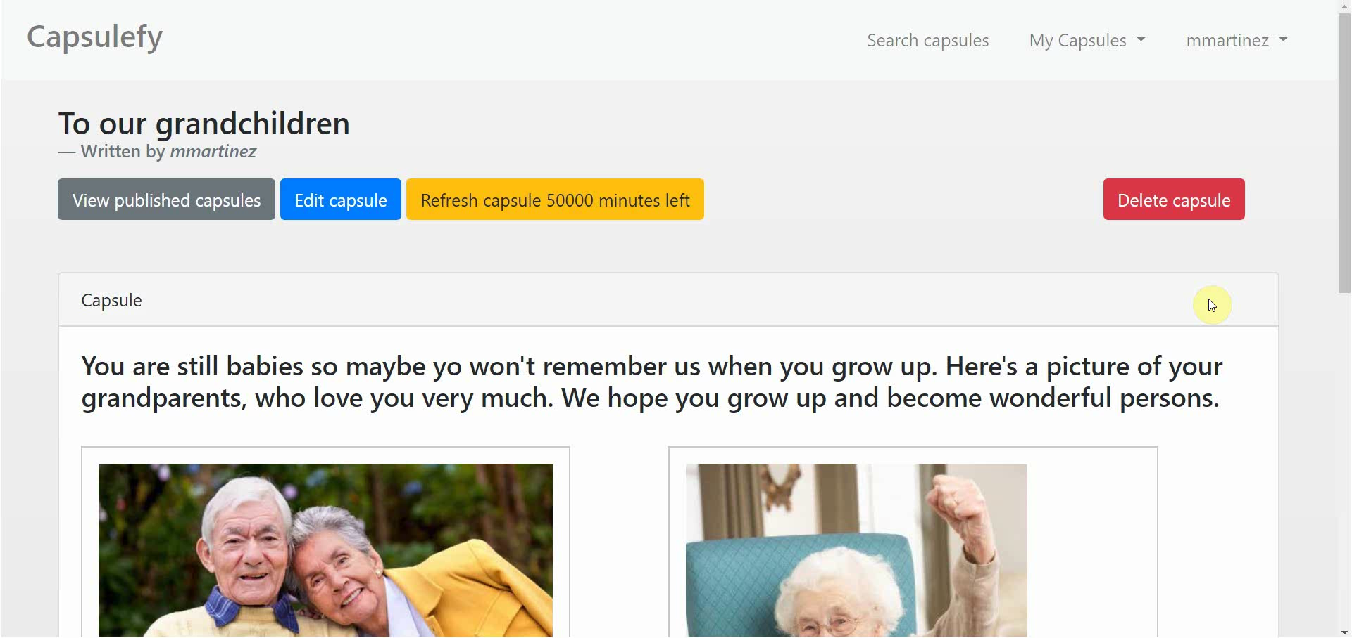
Logged-in user – Delete modules

Slide 52
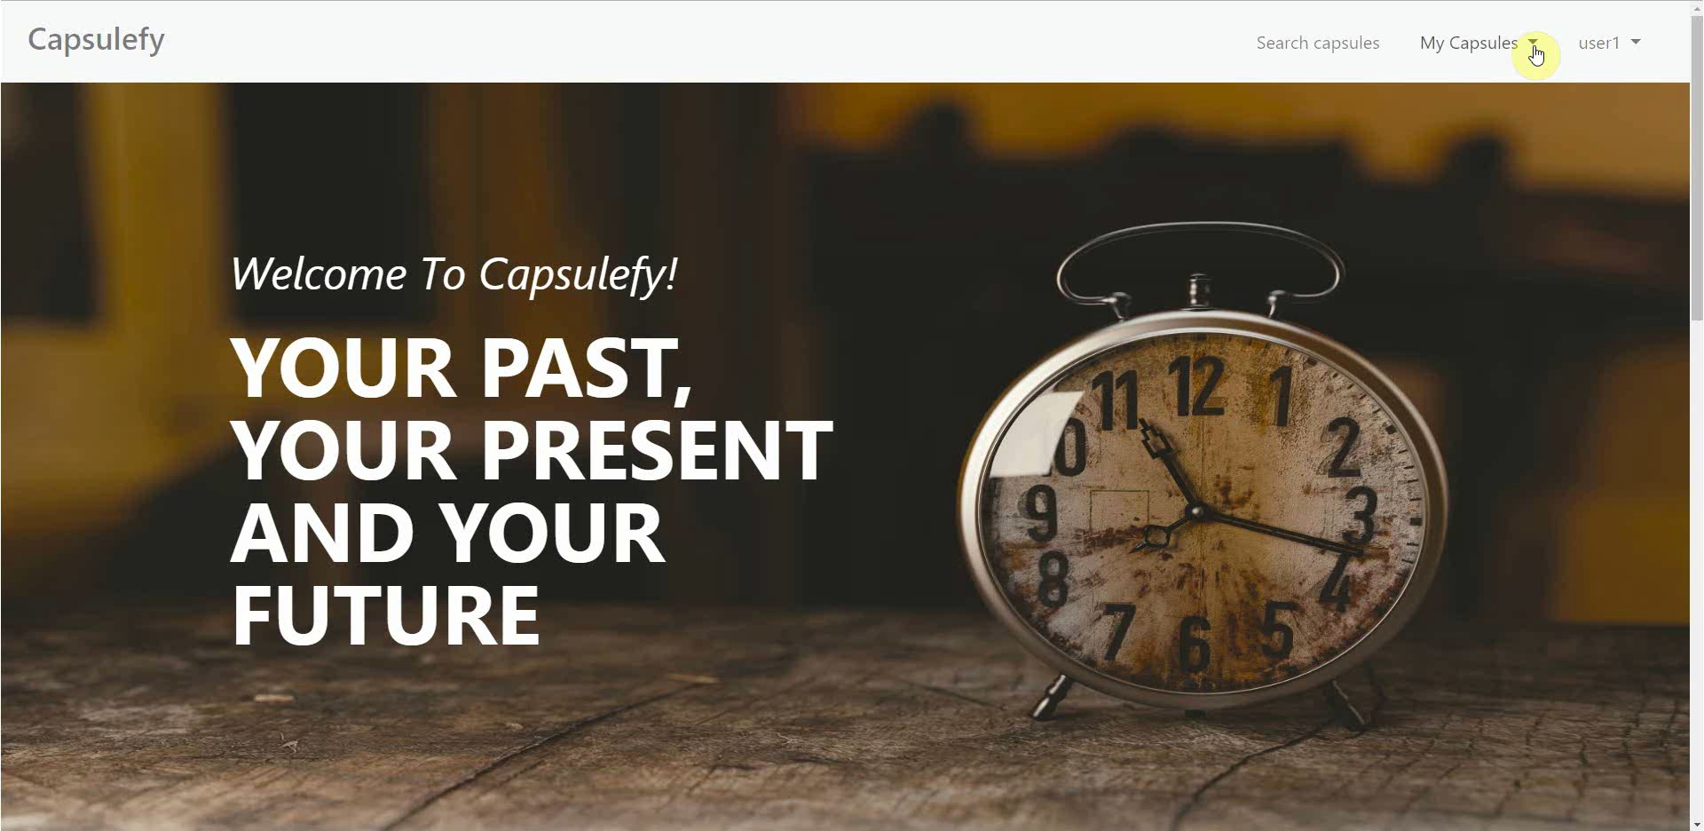
Logged-in user – Refresh timer

Slide 53
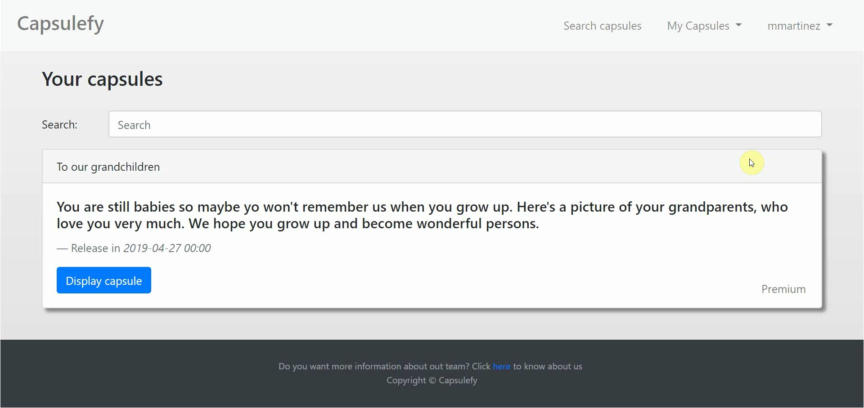
Logged-in user user – Delete capsules

Slide 54
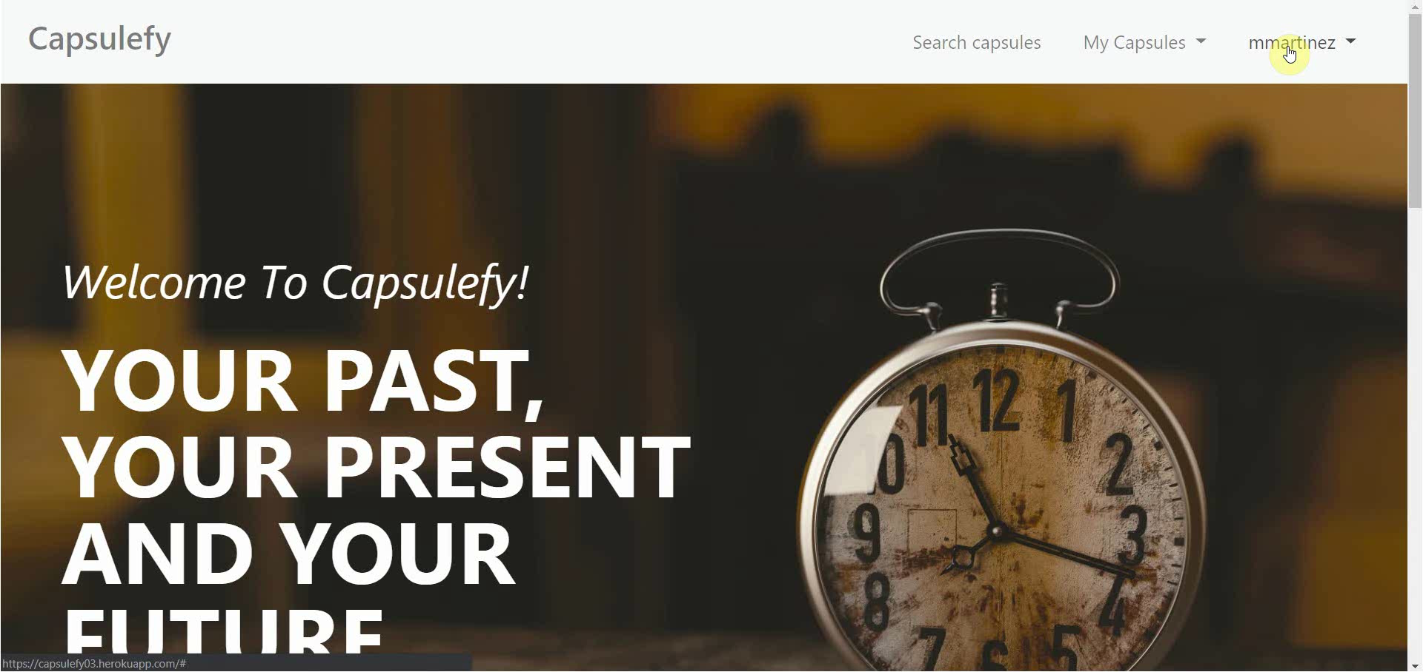
Logged-in user – Delete user data

Slide 55

Admin – List and ban users

Slide 56
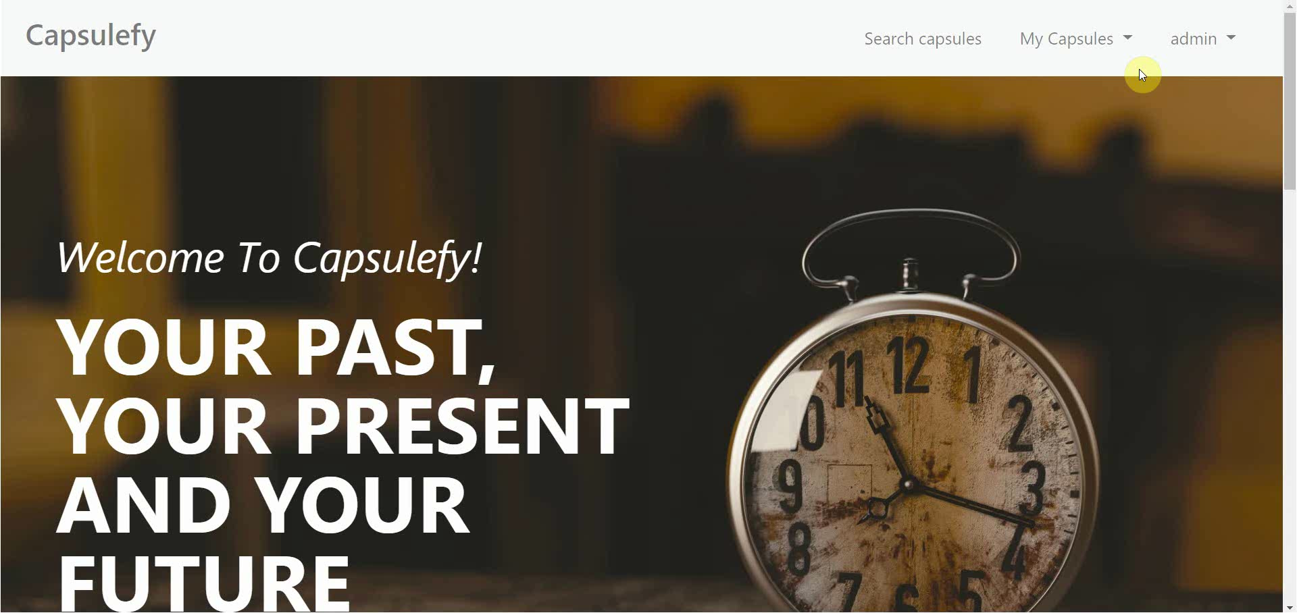
Admin – Dashboard

Slide 57
SPRINT 3 WEEK 2
April 29th – May 3rd

Slide 58
 |  | April |  | May
Task | Assignees | 29 | 30 | 1 | 2 | 3
Feedback meeting | All
Favicon and frontend | Daniel
Name inconsistencies | Adrián
Password restrictions | Juan
Facebook integration | Rafael, Pablo
Review populate | Juan
Deploy app | Adrián
Test app | Daniel, Juan

Slide 59
 |  | April |  | May
Task | Assignees | 29 | 30 | 1 | 2 | 3
Presentation | Rafael
Pilot users form | Pablo
User manual | Pablo
Sprint 3 retrospective doc | Pablo
Rehearsal | Pablo

Slide 60
Project launch
What tasks will we do?

Slide 61





- Finish Facebook integration
- Add creation date to capsules
- Receive new feedback from pilot users
- Advertisement campaign
- Final version of costs
- Final pricing
- Product presentation

Slide 62
PILOTING PLAN
How will users test Capsulefy?

Slide 63




Create manual
Create test suite
Test the system
Gather feedback
Fill form

Slide 64
Committed users
Name | Age
Francisco R. | 55
Javier A. | 19
Valentin A. | 19
Antonio G. | 26
José Manuel J. | 21
Name | Age
Sandra C. | 28
José Manuel C. | 21
Rafael C. | 55
Antonio C. | 54
Auxiliadora L. | 50

Slide 65
Sprint 2
Users receive and fill form
March 30 – April 6
Development
April 8 – April 12
Receive users feedback
April 6
Planification
April 8

Slide 66
Sprint 3
Easter Week
Users receive and fill form
April 12 – April 22
Development
April 22 – May 3
Receive users feedback
April 22
Planification
April 22

Slide 67
second FEEDBACK RESULTS
What did users say?

Slide 68


How did we prioritize?
Depending on:
- Implementation difficulty
- How many users asked for it

Slide 69

“It would be interesting to see the creation and publication dates”

Slide 70


Frontend improvements
Solution
Status
Add creation date (requires model change)
To be determined
Due to backend changes
?
Priority: low

Slide 71
“Passwords should require a minimum length and some special characters”

Slide 72

Password validation
Solution
Status
Add password restrictions
Scheduled
For sprint 3, week 2
***
Priority: medium

Slide 73
“It would be nice to be able to share capsules in Facebook”

Slide 74
Facebook integration
Solution
Status
Add Facebook integration
To be determined
Due to several difficulties
?
Priority: high

Slide 75
“When registering, a date picker for the birthdate would be appreciated”

Slide 76

Frontend improvements
Solution
Status
Add date picker for birthdate
Done
During sprint 3, week 1
Priority: medium

Slide 77
“There is no favicon and some contextual help would be great”

Slide 78

Frontend improvements
Solution
Status
Add favicon and more helpful icons
Scheduled
For sprint 3, week 2
Priority: low

Slide 79
“Some names are different when creating and displaying capsules”

Slide 80
Frontend improvements
Solution
Status
Review and fix inconsistent names
Scheduled
For sprint 3, week 2
abc
Priority: medium

Slide 81
After development
Users receive and fill form
May 4 – May 12
Receive users feedback
May 12
Planification
May 13

Slide 82
Documentation
Manual (PDF)
Test suite
Form
https://forms.gle/NmN7pxV28oh9hCcV6

Slide 83
Thanks!
Upstream: https://capsulefy.herokuapp.com
Sprint 2: https://capsulefy03.herokuapp.com
Landing page: https://capsulefy01.herokuapp.com
Contact email: capsulefy.communications@gmail.com
Pilot users form: https://forms.gle/https://forms.gle/NmN7pxV28oh9hCcV6
GitHub releases: https://github.com/pabreblob/capsulefy/releases

Slide 84


Deadman switch
ON

Slide 85



Teamwork
Skills
Profitable work
Positive feedback

Slide 86
Realistic | 44968 – 46330 €
Optimistic | 43061 €
Pesimistic | 49054 €
Project duration: 4 months

Slide 87

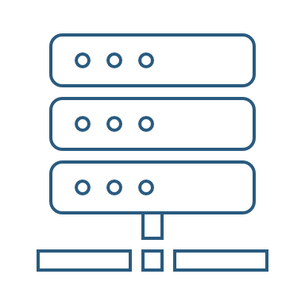

Risk | Mitigation
Broken computer | Risk prevention funds
Changing terms of use | Monitor
Servers down | Monitor
Incompatible timetables | Reschedule

Slide 88
Year 1: 2000 sales
Balance: -10168 €
Year 2: 4000 sales
Balance: 16273 €
29968 €
39600 €
19800 €
13159 €
Costs
Earnings
Costs
Earnings

Slide 89
Year 3: 8000 sales
Balance: 81450 €
79200 €
14023 €
Costs
Earnings

Slide 90

Monthly advertising costs
220 €
140 €
150 €

Slide 91
SPRINT 1 WEEK 1
March 18th – March 22nd

Slide 92
Task | Assignees | Est. (h) | Inv. (h) | Status
Data model | Adrián, Daniel | 4 | 1.5 | Finished
Set up environment | All | 2.5 | 2.5 | Finished
Angular research | Daniel | 1 | 2 | Aborted
Data model implementation | Juan | 2.5 | 2 | Finished
Populate database | Pablo | 2 | 3.2 | Finished
Basic capsule CRUD | Rafael | 2.5 | 9 | To be tested
Display capsules | Adrián | 2 | 5 | To be tested
TIME

Slide 93
Task | Assignees | Est. (h) | Inv. (h) | Status
Listing capsules | Juan | 1.5 | 1 | To be tested
User login | Juan | 1 | 1 | To be tested
Advertisement budget | Pablo | 1.5 | 1.5 | Finished
User interface | Daniel | 1 | 10 | Finished
Documentation | Daniel, Adrián, Juan | 1.5 | 1.5 | Finished
Presentation | Pablo, Rafael | 3 | 4 | Finished
Review meeting | All | 2.5 | 2.5 | Finished
TIME

Slide 94
Performance
Adrián | 1.34
Daniel | 1.05
Rafael | 0.67
Pablo | 0.84
Juan | 1.06

Slide 95


What went wrong?
No Angular knowledge
Bad estimations
Lack of time

Slide 96
SPRINT 1 WEEK 2
March 25th – March 29th

Slide 97
Task | Assignees | Est. (h) | Inv. (h) | Status
Feedback meeting | All | 5 | 5 | Finished
Travis CI set up | Adrián, Rafael | 2 | 3 | Finished
Modular capsules | Adrián | 5 | 4.5 | Finished
Private capsules | Juan | 2 | 1.5 | Finished
Email automation | Juan | 2 | 1.5 | Finished
Search capsules | Daniel | 1.5 | 1 | Finished
List own capsules | Juan | 1 | 1 | Finished
Pagination | Juan | 1 | 3 | Finished
TIME

Slide 98
Task | Assignees | Est. (h) | Inv. (h) | Status
Deadman switch | Pablo | 4 | 5 | Finished
Social network integration | Rafael | 4 | 1 | Postponed
User interface | Daniel | 4 | 7 | Finished
Piloting plan | Adrián | 2.5 | 1 | Finished
Sprint meeting | All | 5 | 5 | Finished
Documentation | Adrián, Daniel, Juan | 1.5 | 1.5 | Finished
Presentation | Rafael | 3 | 5.5 | Finished
Deliverable | Pablo | 3 | 4 | Finished
TIME

Slide 99
Performance
Adrián | 1.32
Daniel | 1.03
Rafael | 0.60
Pablo | 0.77
Juan | 0.87

Slide 100
What went wrong?
Performance further reduced
Implementation differences
Lack of time

Slide 101
What actions were taken?
Meet
Reschedule
Reestimate

Slide 102
Total performance
Adrián | 1.31
Daniel | 1.02
Rafael | 0.63
Pablo | 0.80
Juan | 0.96

Slide 103

Taken actions
Detailed planning
Time for documentation
Better tool usage
Divide tasks

Slide 104
SPRINT 1 RESULTS
What was produced?

Slide 105
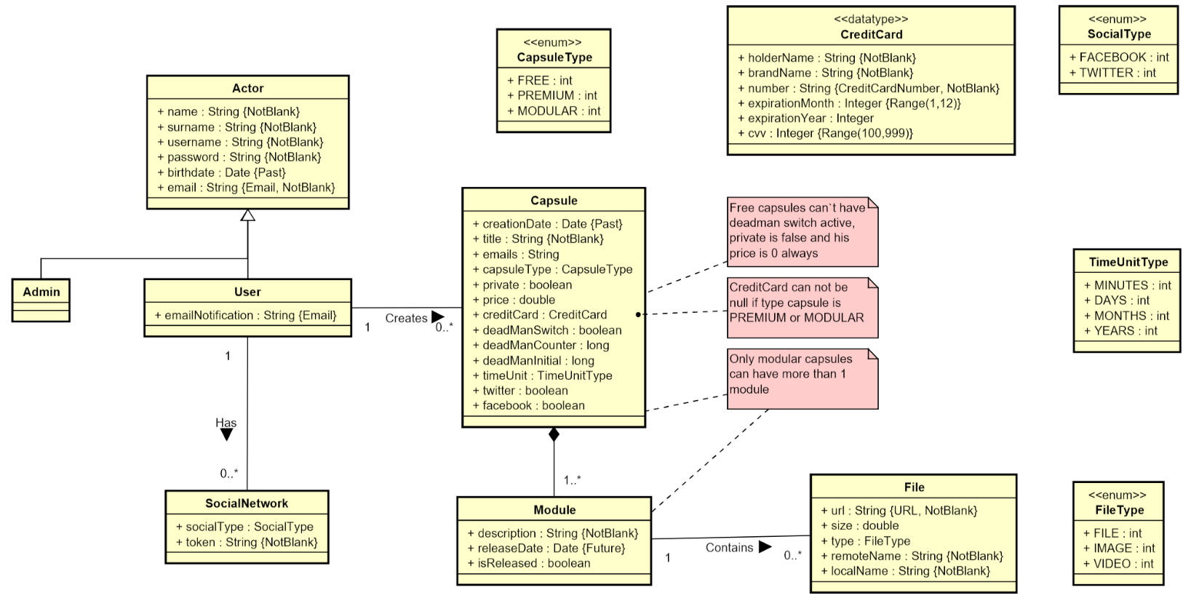

Slide 106
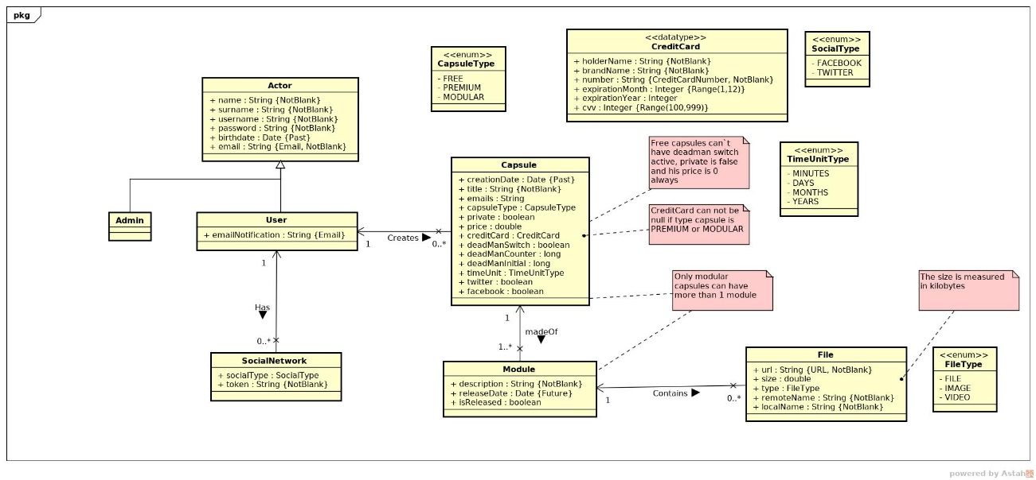

Slide 107
Documentation
Sprint 1 documentation
Piloting plan
Development
Frozen app: https://capsulefy02.herokuapp.com
GitHub release: https://github.com/pabreblob/capsulefy/releases

Slide 108
Project duration | 7 weeks (2 development)
Salaries | 20.80 €/hour
Hours per month | 40
Total salaries | 6989 €
Amortization | 60 months
Equipment | 134.16 €
Hosting | 0 €
Advertising | 0 €
Total | 7123.16 €

Slide 109
Quality (p) | MB/minute
144 | 1.3
240 | 3.3
360 | 5
480 | 8.3
720 | 25
1080 | 50

Slide 110
SPRINT 2 WEEK 1
April 1st – April 7th

Slide 111
 |  | April
Task | Assignees | 1 | 2 | 3 | 4 | 5 | 6 | 7
Initial meeting | All
Local settings | Daniel
User registration | Juan
Remove expired capsules | Pablo
Twitter integration | Rafael
Update modular form | Adrián
Fix pagination issues | Juan
DM email notifications | Pablo

Slide 112
 |  | April
Task | Assignees | 1 | 2 | 3 | 4 | 5 | 6 | 7
UI: Registration | Daniel
Ban users | Juan
UI: User account | Daniel
Automations | Pablo
Basic payment | Adrián
Presentation | Rafael
UI: List and search users | Daniel
Rehearsal | Pablo

Slide 113
Unplanned tasks
Task | Assignees | Invested time (h)
Travis test problems | Daniel | 1.5
Check DM switch when editing capsules | Daniel | 0.25
Fix AJAX search | Juan | 0.5
Add tooltip for notification emails | Daniel | 1
Improve registration form | Juan | 2

Slide 114
Performance
Pablo (PM) | 0.93
Daniel | 1.44
Rafael | 1
Adrián | 0.94
Juan | 1.08

Slide 115
Sprint 1 problem
Bad estimations
Solution:
Divide tasks

Slide 116
Measures
Performance ratio
!
~
?
0.5
0.8
1.2
1.5
Divide tasks
W1 lowest performance: 0.93

Slide 117

Measures
Delay (days)
2
Divide tasks
W1 greatest delay: 2

Slide 118
Measures
Invested hours
6
Divide tasks
W1 task with most hours: 6

Slide 119
Measures
Invested days
6
Divide tasks
W1 task with most days: 5

Slide 120
Sprint 1 problem
Poor tool usage
Solution:
Better tool usage

Slide 121
Measures
Wiki entries
~4
Better
tool usage
Wiki entries after W1: 5

Slide 122
What went wrong?
- What happened?
Django 2.2 broke our tests.
- Solution
Migrate to Django 2.2 and fix
all tests.
Django update

Slide 123
What went wrong?
- Measure
Number of failing tests
Django update
0
Number after W1: 0

Slide 124


What went wrong?
- What happened?
Late deployment led to many
errors.
- Solution
Deploy 2 days before deadline.
Deployment
problems

Slide 125
What went wrong?
- Measure
Days before deadline
Deployment
problems
2
Days in W1: 0

Slide 126
Project duration | 8 weeks (3 development)
Salaries | 20.80 €/hour
Hours per month | 40
Total salaries | 8207 €
Amortization | 60 months
Equipment | 200 €
Hosting | 0 €
Advertising | 0 €
Total | 8407 €

Slide 127
Task | Assign. | Start | End | Est. (h) | Inv. (h)
Initial meeting | All | Apr 1 | Apr 1 | 1.5 | 1.5
Local settings | Daniel | Apr 2 | Apr 2 | 1 | 0.5
User registration | Juan | Apr 2 | Apr 2 | 2 | 2
Remove expired capsules | Pablo | Apr 2 | Apr 2 | 1.5 | 1.5
Twitter integration | Rafael | Apr 2 | Apr 4 | 4 | 4
Update modular form | Adrián | Apr 2 | Apr 3 | 5 | 6
Fix pagination issues | Juan | Apr 3 | Apr 3 | 1.5 | 1.5
DM switch notifications | Pablo | Apr 3 | Apr 4 | 1.5 | 2
UI: Registration | Daniel | Apr 3 | Apr 4 | 0.5 | 0.25
TIME

Slide 128
Task | Assign. | Start | End | Est. (h) | Inv. (h)
Ban users | Juan | Apr 4 | Apr 6 | 2 | 1.5
UI: User account | Daniel | Apr 4 | Apr 6 | 1.5 | 1.25
Automation improvements | Pablo | Apr 4 | Apr 7 | 4 | 4.5
Basic payment | Adrián | Apr 5 | Apr 7 | 4 | 4
Presentation | Rafael | Apr 5 | Apr 7 | 3 | 3
UI: List and search users | Daniel | Apr 6 | Apr 7 | 2 | 2
Rehearsal | Pablo | Apr 7 | Apr 7 | 1.5 | 1
TIME

Slide 129
SPRINT 2 WEEK 2
April 8th – April 12th

Slide 130
 |  | April
Task | Assignees | 8 | 9 | 10 | 11 | 12
Feedback meeting | All
Fix functional tests | Adrián
Admin dashboard | Juan
Delete user data | Pablo
Add date picker | Adrián
Fix notification emails | Daniel
Add confirmation button | Daniel
Edit notifications emails | Rafael

Slide 131
 |  | April
Task | Assignees | 8 | 9 | 10 | 11 | 12
“About us” page | Daniel
Add return button | Daniel
Fix frontend errors | Daniel
Deploy app | Adrián
Test app | Daniel, Juan
Presentation | Rafael
Pilot users form | Pablo
User manual | Pablo

Slide 132
 |  | April
Task | Assignees | 8 | 9 | 10 | 11 | 12 | 20 | 21
Sprint 2 retrospective doc | Pablo
Rehearsal | Pablo

Slide 133
Unplanned tasks
Task | Assignees | Invested time (h)
Update populate | Pablo | 0.5
Fix capsule edition URL | Adrián | 0.25

Slide 134
Performance
Pablo (PM) | 1.23
Daniel | 1.9
Rafael | 0.96
Adrián | 1.33
Juan | 1

Slide 135
Measures
Performance ratio
!
~
?
0.5
0.8
1.2
1.5
Divide tasks
W2 lowest performance: 0.96

Slide 136
Measures
Delay (days)
2
Divide tasks
W2 greatest delay: 0

Slide 137
Measures
Invested hours
6
Divide tasks
W2 task with most hours: 5.5

Slide 138
Measures
Invested days
6
Divide tasks
W2 task with most days: 5

Slide 139
Measures
Wiki entries
~4
Better
tool usage
Wiki entries after W2: 5

Slide 140
What went wrong?
- Measure
Days before deadline
Deployment
problems
2
Days in W2: 2

Slide 141

What went wrong?
No problems during week 2!

Slide 142
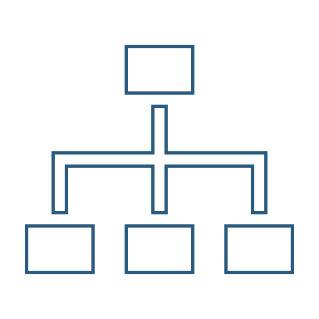
Why?
- No complex tasks
- No technical problems
- Main frontend already developed

Slide 143

Delayed tasks
- Facebook integration
- Performance tests
- SonarCloud set up

Slide 144
Lessons learnt
Software updates
Monitor and test

Slide 145
Lessons learnt
Late deployment
Earlier deployments

Slide 146
Lessons learnt
No piloting plan feedback
Earlier feedback discussion

Slide 147

Lessons learnt
Changes affecting data
Review populate script

Slide 148
Lessons learnt
Higher performance
Better estimations

Slide 149


Lessons learnt
Bug tracking
GitHub issues ratios

Slide 150
GitHub issues ratios
- Bugs over new features
Current ratio: 8/128=0.06
- Time invested on bugs over time invested on new features

Slide 151
Project duration | 9 weeks (4 development)
Salaries | 20.80 €/hour
Hours per month | 40
Total salaries | 9217 €
Amortization | 60 months
Equipment | 238 €
Hosting | 0 €
Advertising | 0 €
Total | 9455 €

Slide 152
SPRINT 2 RESULTS
What was produced?

Slide 153
Documentation
Sprint 2 documentation
Updated user manual and pilot users form
Development
Frozen app: https://capsulefy03.herokuapp.com
GitHub release: https://github.com/pabreblob/capsulefy/releases

Slide 154
Task | Assign. | Start | End | Est. (h) | Inv. (h)
Feedback meeting | All | Apr 8 | Apr 8 | 1.5 | 1.5
Fix functional tests | Adrián | Apr 8 | Apr 10 | 0.75 | 0.5
Admin dashboard | Juan | Apr 8 | Apr 10 | 3 | 3
Delete user data | Pablo | Apr 8 | Apr 10 | 1.5 | 2
Add date picker | Adrián | Apr 8 | Apr 10 | 1 | 1
Fix notification emails | Daniel | Apr 8 | Apr 10 | 0.5 | 0.2
Add confirm button | Daniel | Apr 8 | Apr 10 | 1 | 0.4
Edit notification email | Rafael | Apr 8 | Apr 10 | 1 | 1
TIME

Slide 155
Task | Assign. | Start | End | Est. (h) | Inv. (h)
“About us” page | Daniel | Apr 8 | Apr 10 | 0.25 | 0.25
Add return button | Daniel | Apr 8 | Apr 10 | 1 | 0.25
Fix frontend errors | Daniel | Apr 8 | Apr 10 | 1.5 | 1.5
Deploy app | Adrián | Apr 10 | Apr 10 | 2 | 1.5
Test app | Daniel, Juan | Apr 10 | Apr 12 | 2 | 2
Presentation | Rafael | Apr 10 | Apr 12 | 5 | 5.5
Pilot user form | Pablo | Apr 8 | Apr 12 | 1.5 | 2
User manual | Pablo | Apr 8 | Apr 12 | 1 | 0.75
TIME

Slide 156
Task | Assign. | Start | End | Est. (h) | Inv. (h)
Sprint 2 retrospective doc | Pablo | Apr 8 | Apr 12 | 4 | 4
Rehearsal | Pablo | Apr 20 | Apr 21 | 1.5 | -
TIME

Slide 157
SPRINT 3 WEEK 1
April 22th – April 28th

Slide 158
Task | Assign. | Start | End | Est. (h) | Inv. (h)
Initial meeting | All | Apr 22 | Apr 22 | 1.5 | 1.5
Improve checkboxes | Daniel | Apr 22 | Apr 22 | 2 | 1.75
Coverage tests | Rafael | Apr 23 | Apr 23 | 1 | 1
Unit tests | Adrián | Apr 23 | Apr 24 | 5 | 6
Improve responsive | Daniel | Apr 23 | Apr 26 | 1 | 1
Improve demo videos | Adrián | Apr 23 | Apr 25 | 1 | 1
Add date picker | Juan | Apr 23 | Apr 24 | 0.5 | 0.5
Fix sign up message | Juan | Apr 24 | Apr 25 | 0.5 | 0.5
TIME

Slide 159
Task | Assign. | Start | End | Est. (h) | Inv. (h)
Update costs | Pablo | Apr 24 | Apr 25 | 1.5 | 1
GDPR | Pablo | Apr 24 | Apr 24 | 2 | 1.5
Improve return button | Daniel | Apr 24 | Apr 25 | 0.5 | 0.75
Improve 404 pages | Daniel | Apr 24 | Apr 25 | 0.5 | 0.5
Improve email inputs | Daniel | Apr 24 | Apr 24 | 1 | 1.25
Landing page content | Juan | Apr 24 | Apr 25 | 1.5 | 1
Fix image proportions | Daniel | Apr 24 | Apr 25 | 0.5 | 1
Test automation results | Pablo | Apr 25 | Apr 26 | 1.5 | 0.5
TIME

Slide 160
Task | Assign. | Start | End | Est. (h) | Inv. (h)
Improve dashboard | Juan | Apr 25 | Apr 26 | 2 | 2
Review populate | Pablo | Apr 25 | Apr 25 | 1 | 0.75
Presentation | Rafael | Apr 26 | Apr 28 | 3 | 3.5
Advertisement video | Pablo | Apr 27 | Apr 28 | 2 | 2
Rehearsal | Pablo | Apr 28 | Apr 28 | 1 | 1
TIME

Slide 161
SPRINT 3 WEEK 2
April 29th – May 3rd

Slide 162
Task | Assign. | Start | End | Est. (h) | Inv. (h)
Feedback meeting | All | Apr 29 | Apr 29 | 1.5 | -
Favicon, frontend | Daniel | Apr 29 | Apr 30 | 1.5 | -
Name inconsist. | Adrián | Apr 29 | Apr 30 | 1 | -
Password restrict. | Juan | Apr 29 | Apr 30 | 1.5 | -
Facebook integr. | Rafael, Pablo | Apr 29 | May 1 | 4 | -
Review populate | Juan | Apr 30 | Apr 30 | 1 | -
Deploy app | Adrián | May 1 | May 1 | 2 | -
Test app | Daniel, Juan | May 1 | May 3 | 4 | -
TIME

Slide 163
Task | Assign. | Start | End | Est. (h) | Inv. (h)
Presentation | Rafael | May 1 | May 3 | 5 | -
Pilot users form | Pablo | May 1 | May 3 | 1.5 | -
User manual | Pablo | May 1 | May 3 | 1 | -
Sprint 3 retrospective doc | Pablo | May 1 | May 3 | 4 | -
Rehearsal | Pablo | May 3 | May 3 | 1.5 | -
TIME

